Slide 1
Graphs and Tree
CSE 103

Slide 2
Cut vertex
Sometimes the removal from a graph of a vertex and all incident edges produces a subgraph with more connected components. Such vertices are called cut vertices

Slide 3
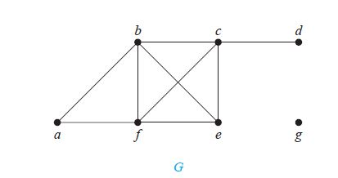
degree
A vertex of degree zero is called isolated. Vertex g in graph G in Example 1 is isolated.
A vertex is pendant if and only if it has degree one. Vertex d in graph G in Example 1 is pendant.

Slide 4
Tree
DEFINITION 1 A tree is a connected undirected graph with no simple circuits.
DEFINITION 2 A rooted tree is a tree in which one vertex has been designated as the root and every edge is directed away from the root.
The terminology for trees are parent, child, siblings, ancestors, descendants.

Slide 5
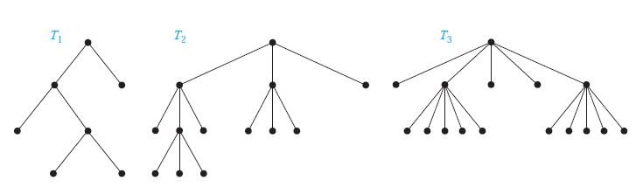
DEFINITION 3 A rooted tree is called an m-ary tree if every internal vertex has no more than m children. The tree is called a full m-ary tree if every internal vertex has exactly m children. An m-ary tree with m = 2 is called a binary tree.

Slide 6
Binary search tree
Form a binary search tree for the words mathematics, physics, geography, zoology, meteorology, geology, psychology, and chemistry (using alphabetical order).

Slide 7
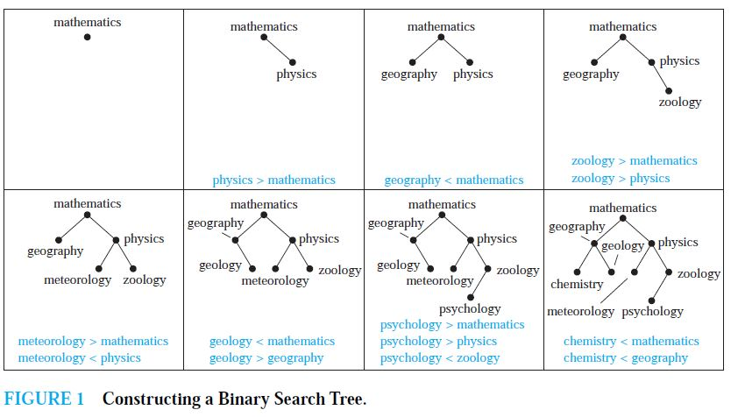
Binary search tree

Slide 8
ORDERED ROOTED TREES An ordered rooted tree is a rooted tree where the children of each internal vertex are ordered.
Example: Binary tree
THEOREM 2 A tree with n vertices has n − 1 edges.
THEOREM 3 A full m-ary tree with i internal vertices contains n = mi + 1 vertices.

Slide 9
THEOREM 4 A full m-ary tree with
(i ) n vertices has i = (n − 1)/m internal vertices and l = [(m − 1)n + 1]/m leaves,
(ii ) i internal vertices has n = mi + 1 vertices and l = (m − 1)i + 1 leaves,
(iii ) l leaves has n = (ml − 1)/(m − 1) vertices and i = (l − 1)/(m − 1) internal vertices.

Slide 10
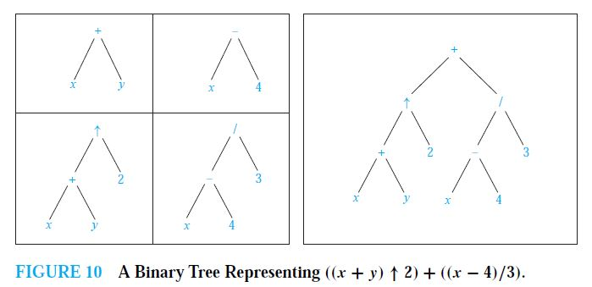
Infix, Prefix, and Postfix Notation
What is the ordered rooted tree that represents the expression ((x + y)↑2) + ((x − 4)/3)? => This is infix form.

Slide 11
What is the prefix form for ((x + y) ↑ 2) + ((x − 4)/3)?
Solution: We obtain the prefix form for this expression by traversing the binary tree that represents it in preorder, shown in Figure 10. This produces + ↑ + x y 2 / − x 4 3.

Slide 12
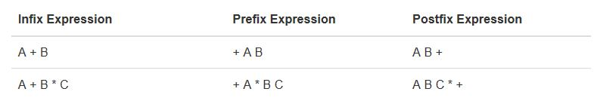

Slide 13
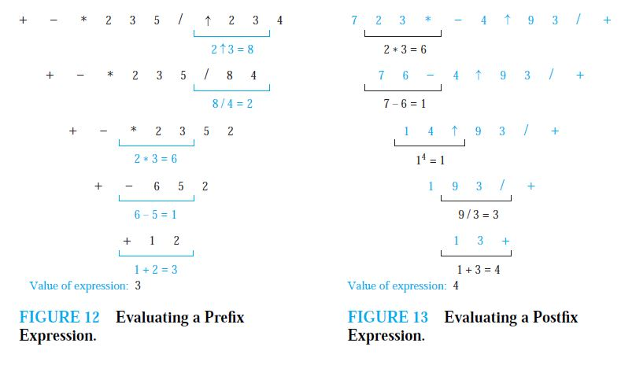

Slide 14
What is the value of the prefix expression + − ∗ 2 3 5/↑ 2 3 4?
What is the value of the postfix expression 7 2 3 ∗ − 4 ↑ 9 3/+?

